Slide 1

Topic:
Deliciosso App - UI DESIGN
Presented by:
Shilpa Gaikwad

Slide 2


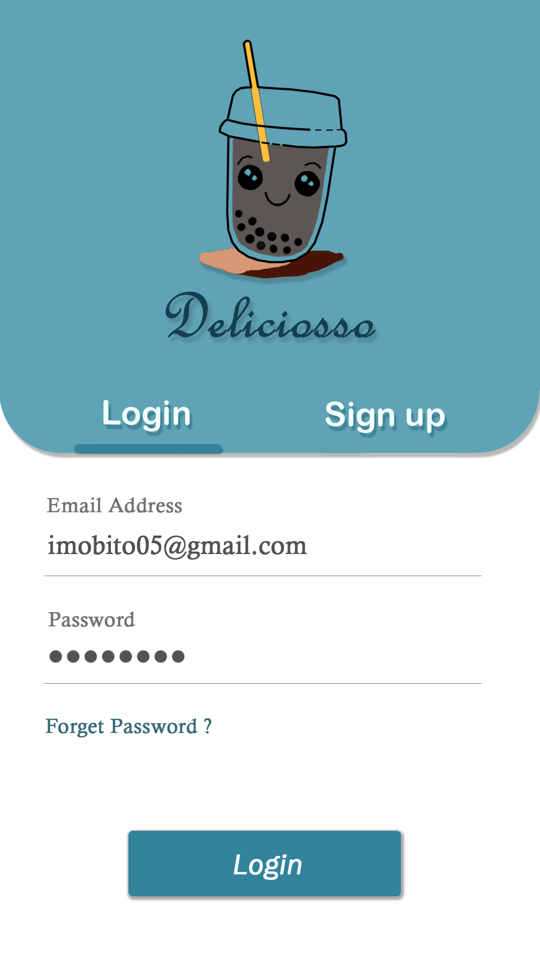
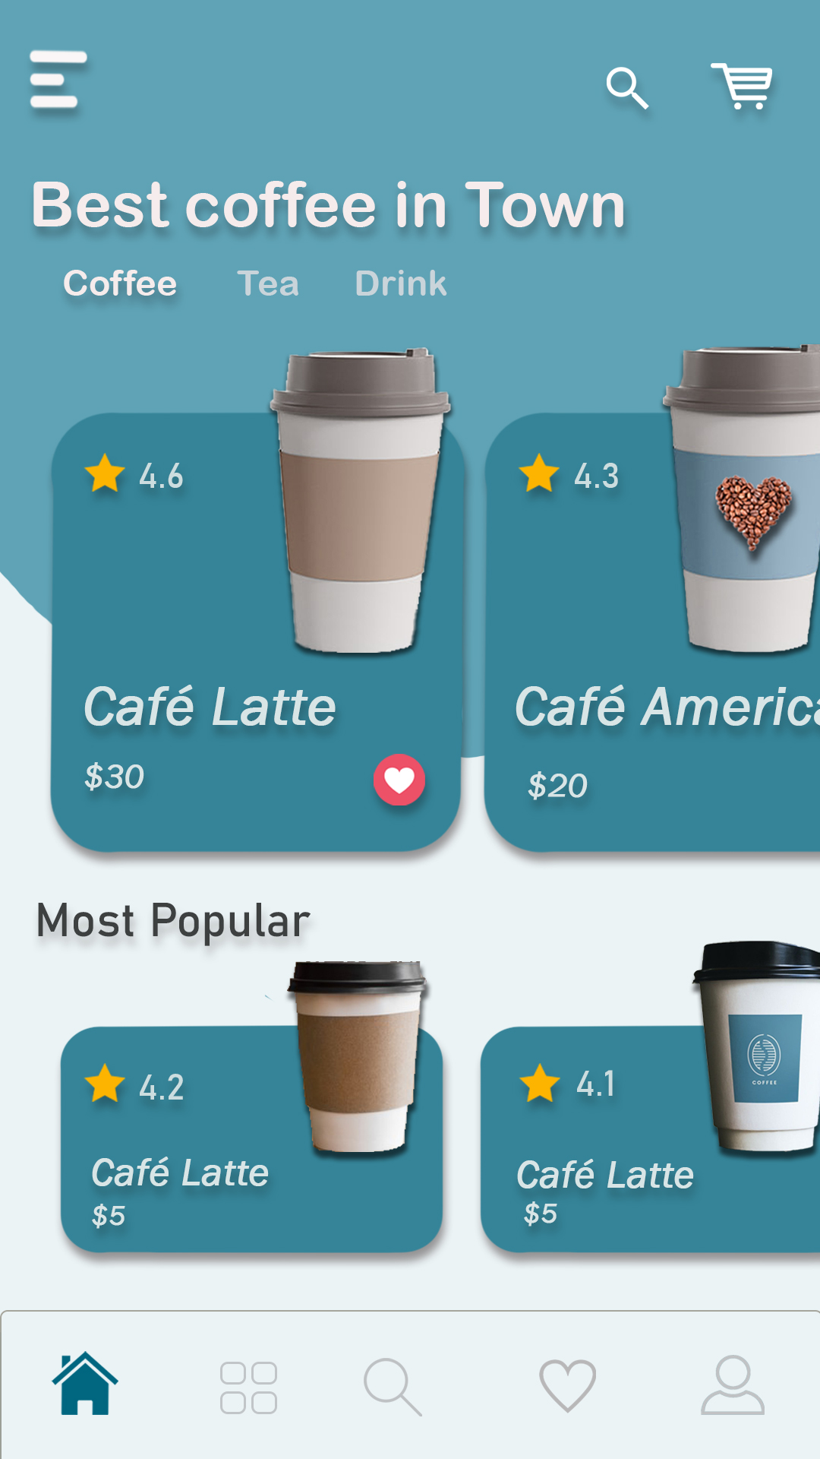
Loading page
Login page
Home page

Slide 3
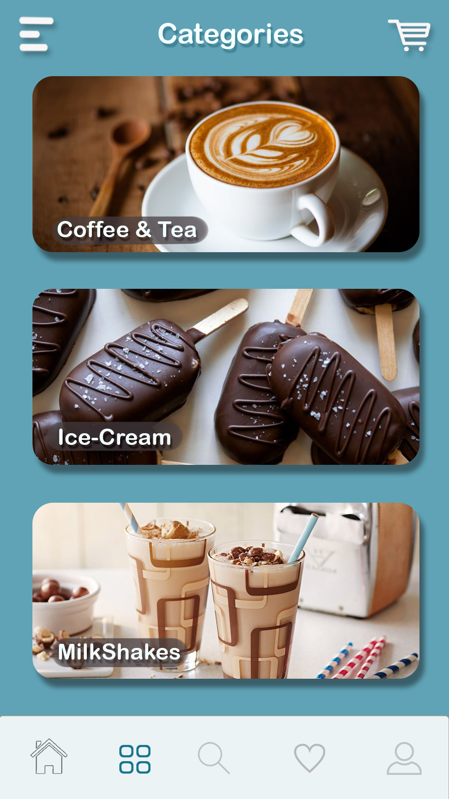
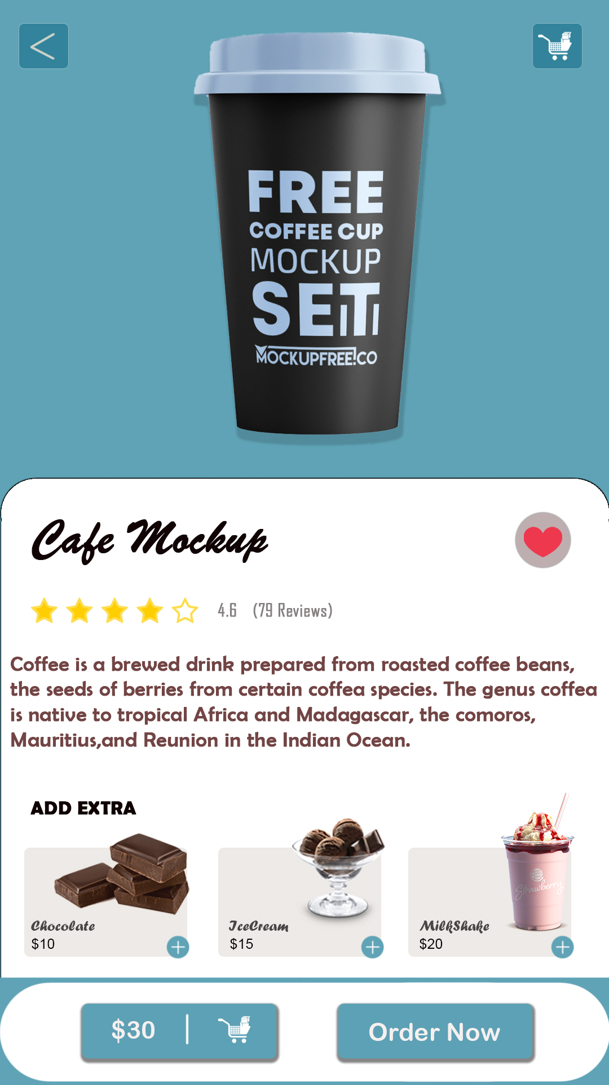
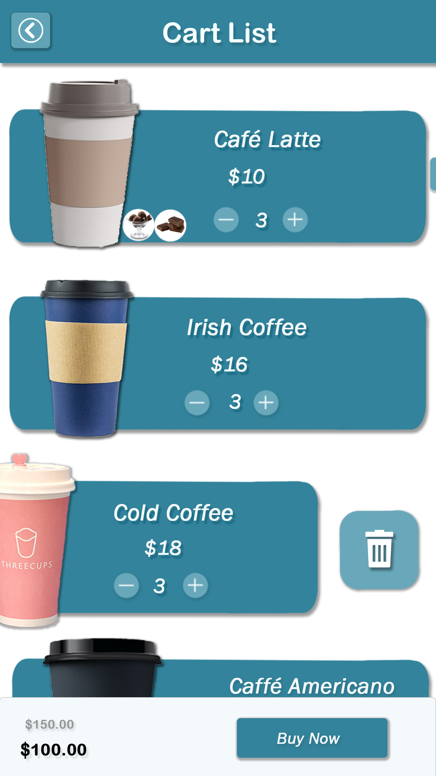
Categories Page
Coffee detail Page
Cart Page

Slide 4
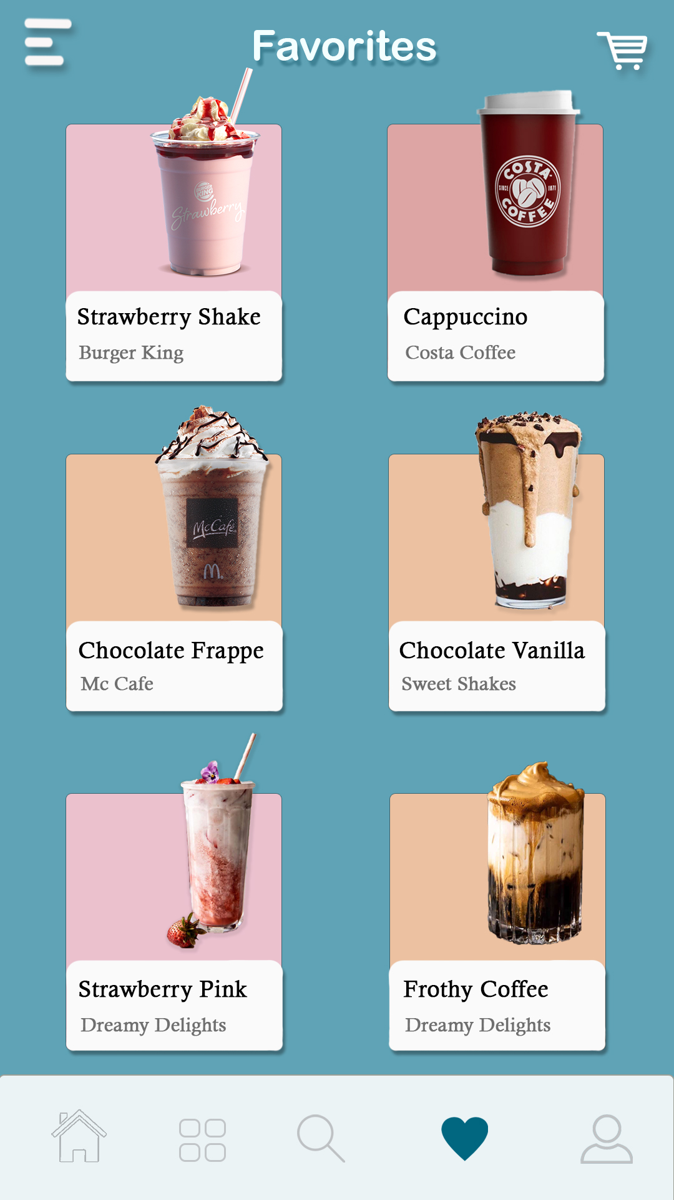
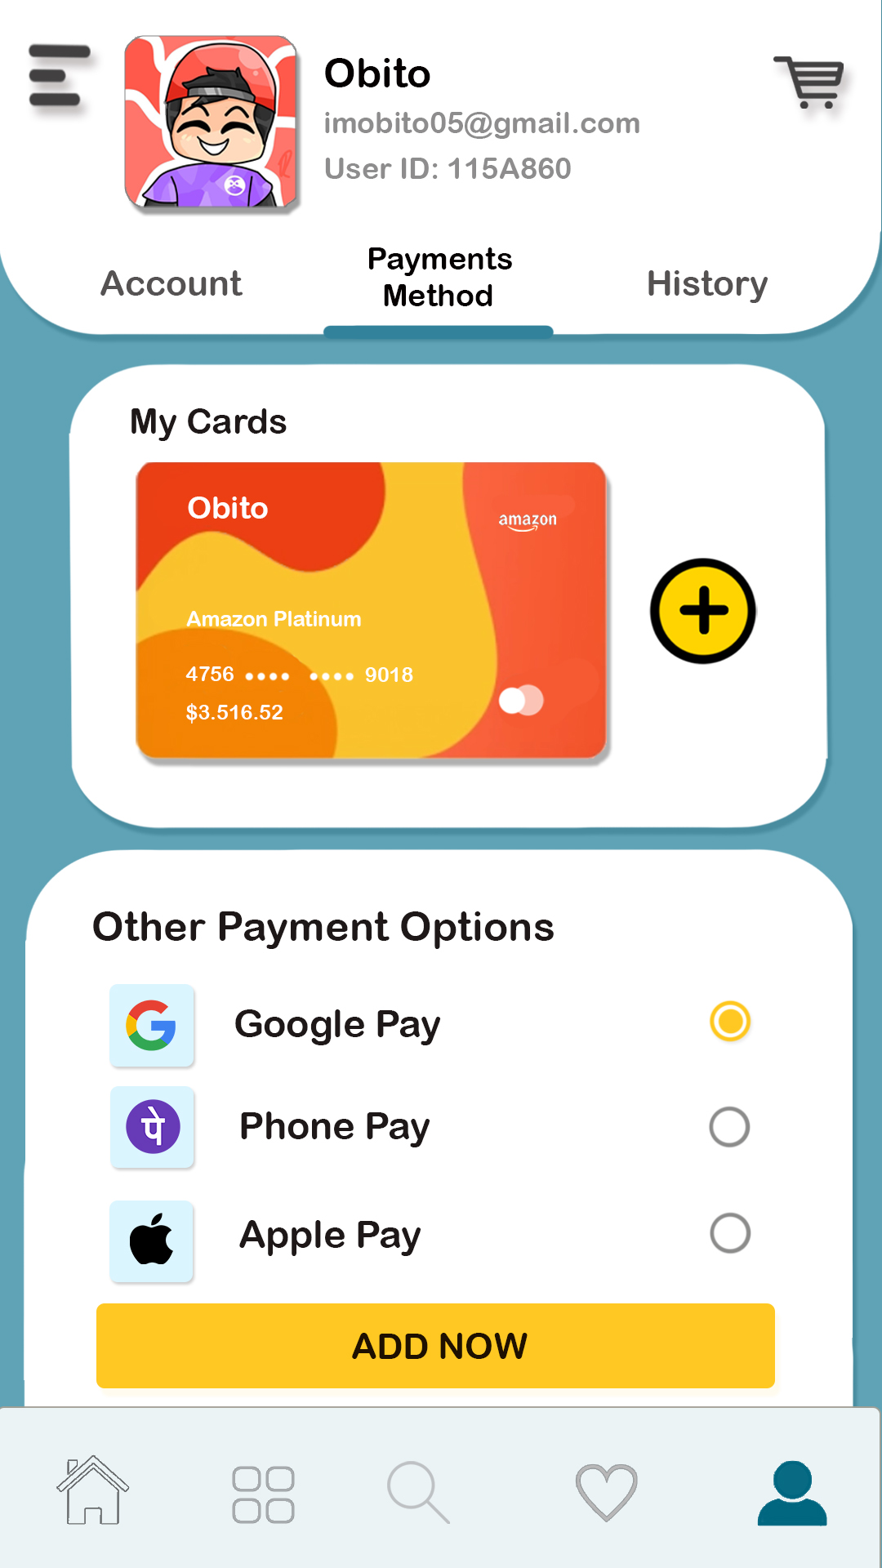
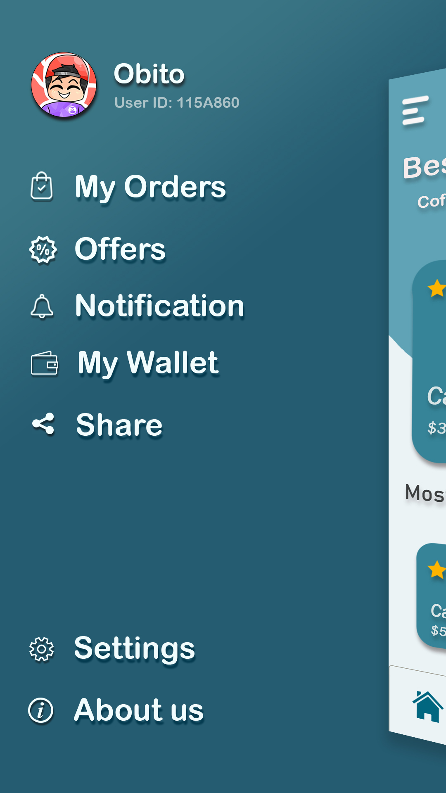
Favorite Page
Profile Page
Side Menu Page

Slide 5
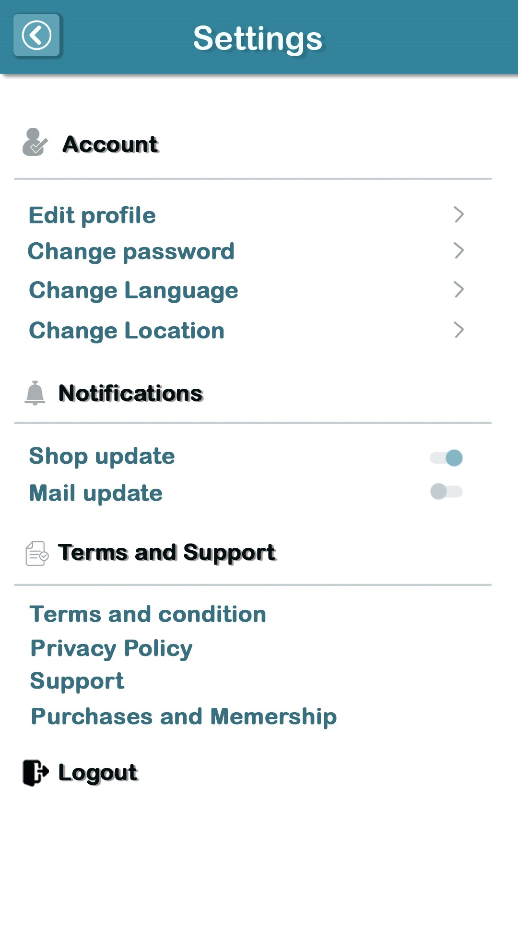
Settings Page

Slide 6
Thank
YOU

